Slide 1
AOOP LAB Group Project
“Online Covid-19 Vaccine Registration System”
Prepared by-
Syed Abu Ammar Muhammad Zarif (011202009)
Mir Rezowan Ahmed (011202025)
Anika Tabassum Orchi (11201346)

Slide 2
3 Basic functionility of this project:
User could ensure their registration and also could able to access thier individual profile for keeping the track.
Volunteers are welcome to help in this vaccination process after completing their individual registration.
There are three admins, those who are maintaining and monitoring the whole process from the backend.

Slide 3
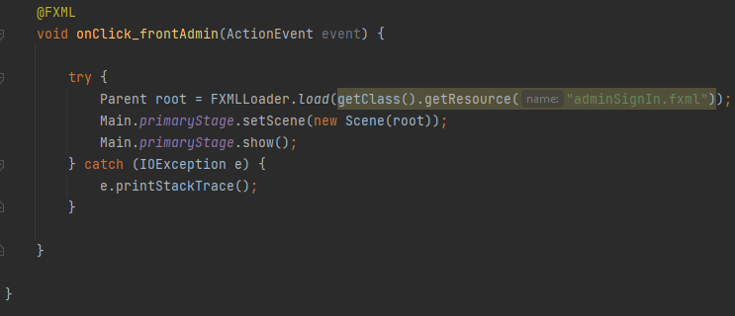
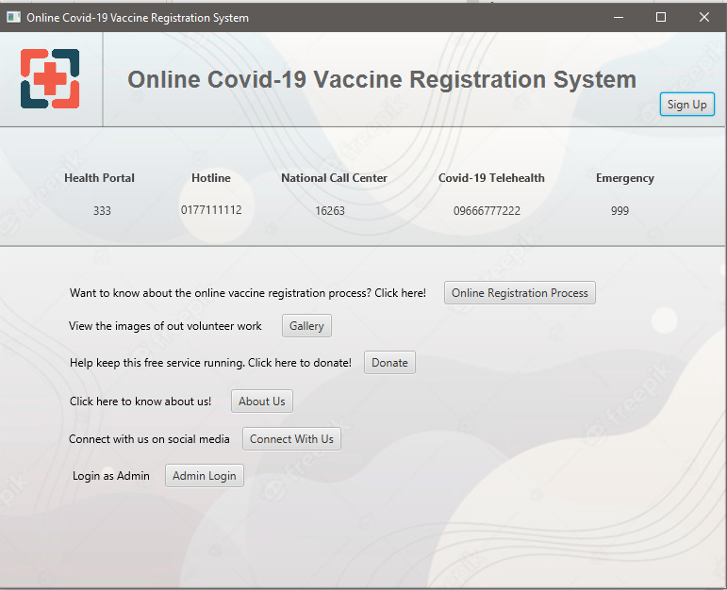
Various buttons are being handled.
Provided with the hotline numbers.
The most important buttons in this UI are “Sign up” and “Admin Login”

Slide 4
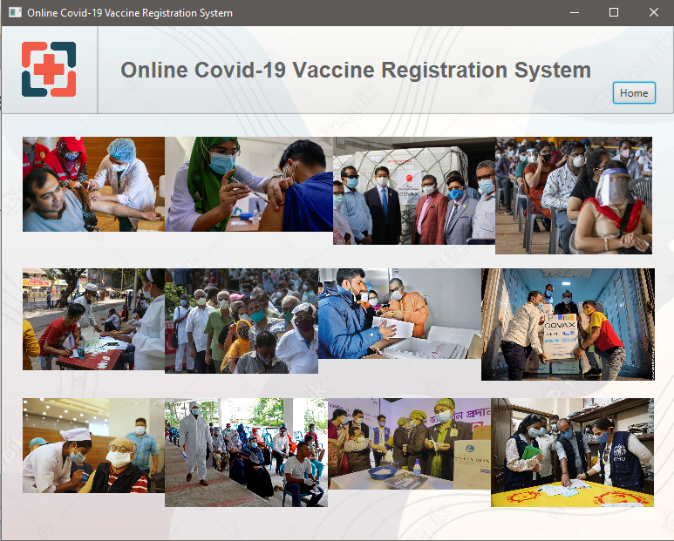
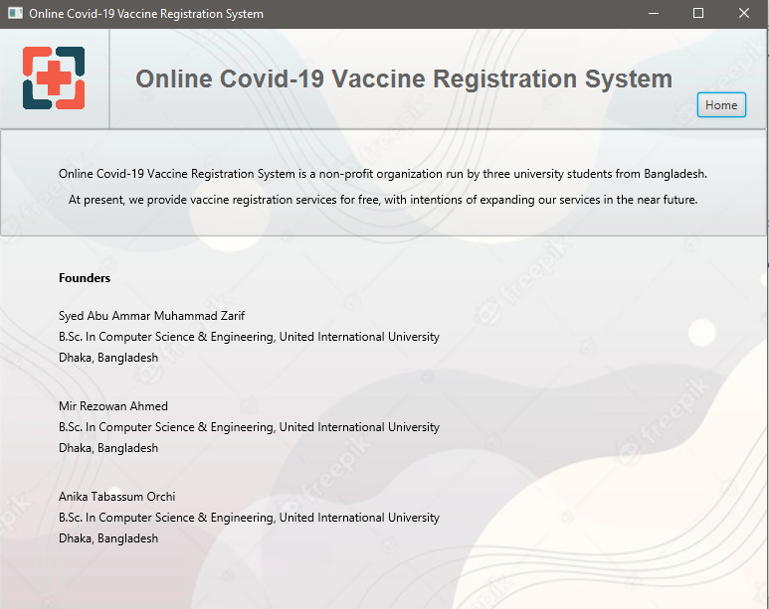
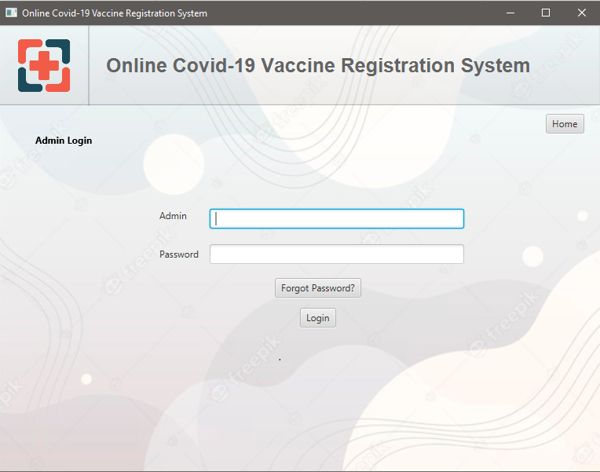
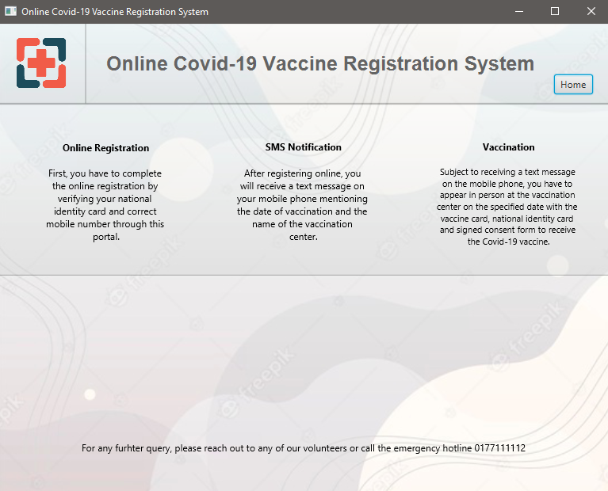
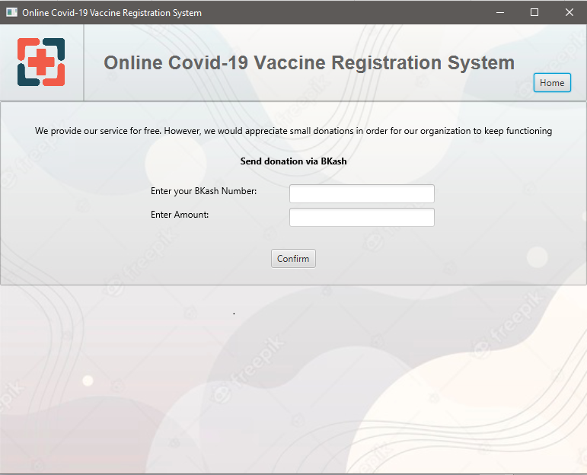
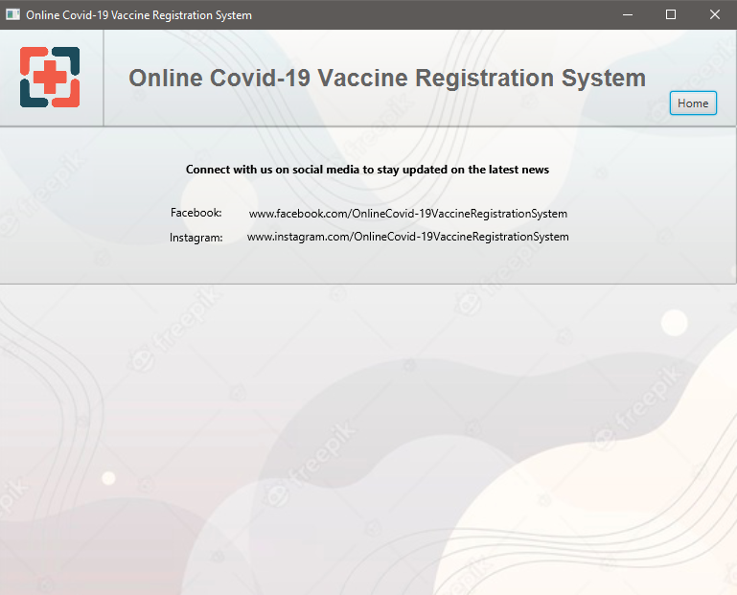
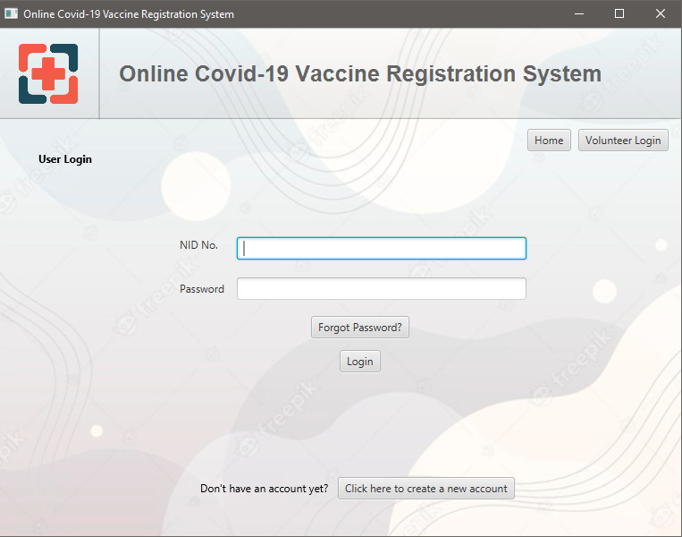
The place we can move from our front page:
Buttons
Buttons
Online
Registration
Process
Gallery
Donate
About us
Connect
With Us
Admin
Login
Sign Up

Slide 5
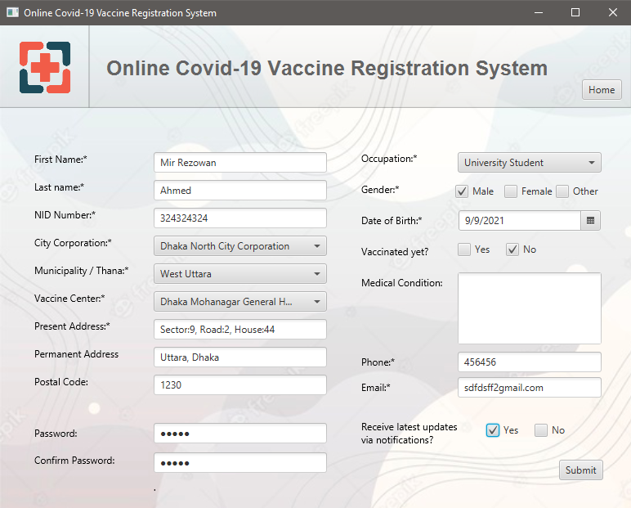
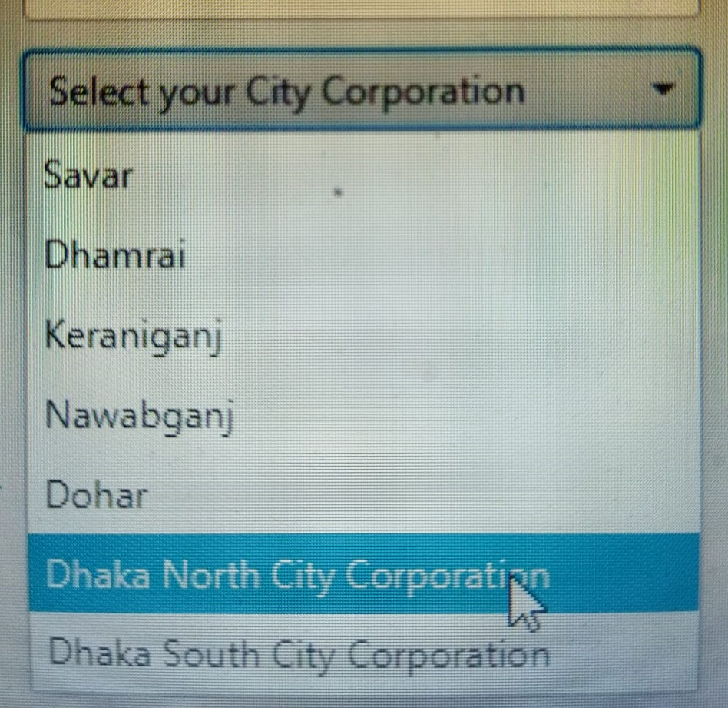
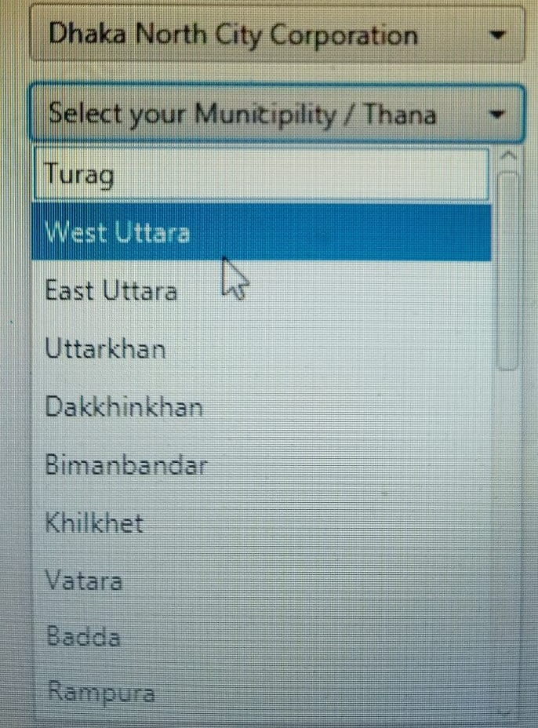
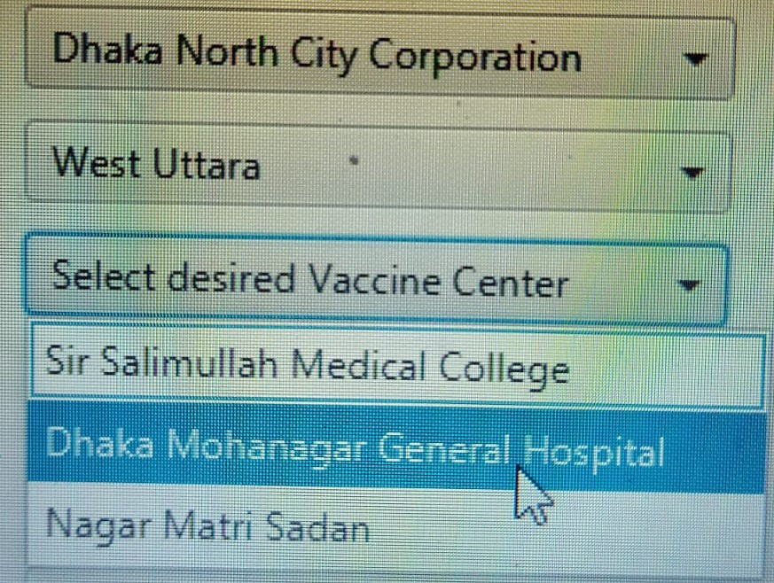
First an User need to register to get the vaccine:
Neccessary infromation need to be provided.
Finally after pressing the “Submit” button
the registraion will be completed if there are
available vaccines in our end.
Can select the vaccine center near by
the User.

Slide 6
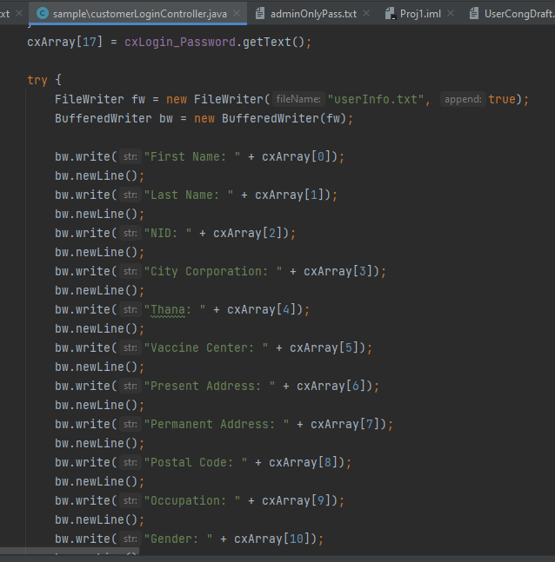
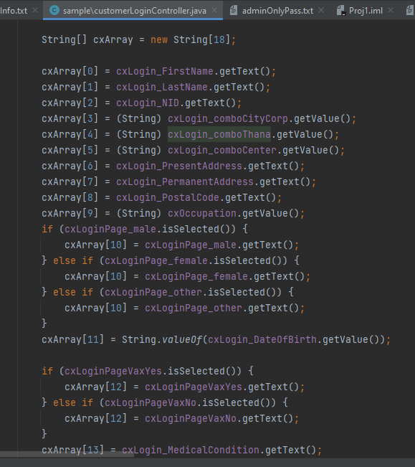
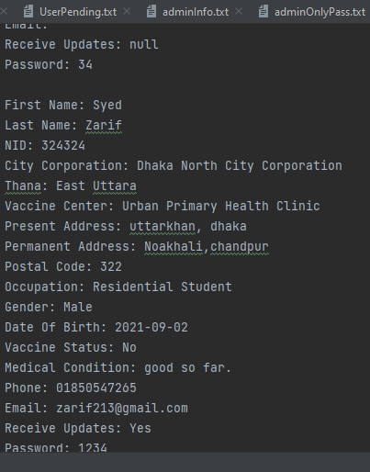
Permanent storage system for User:
Information of each User are stored in our permanent storage system(File).

Slide 7
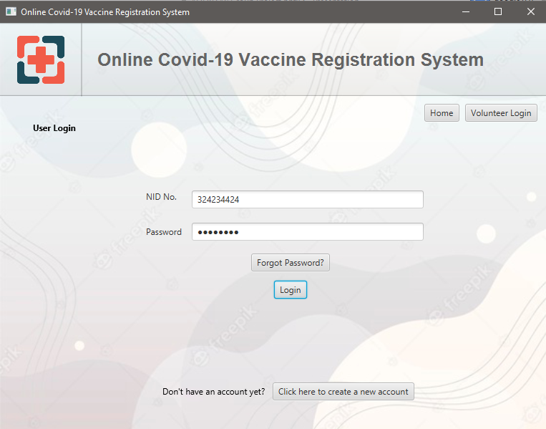
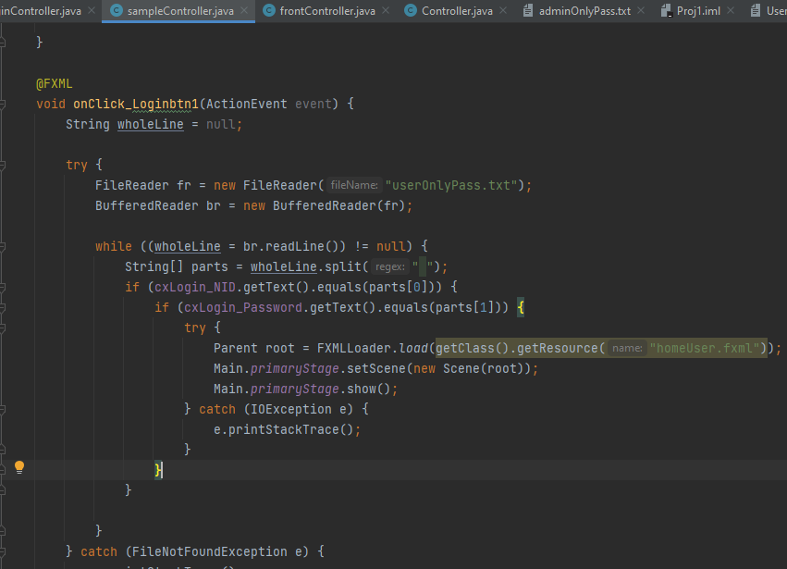
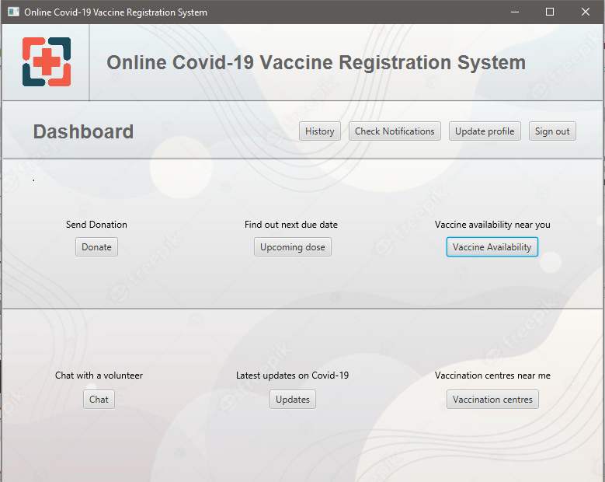
Finally we are in our User Login UI:
Password have to be matched in order
to get access in their individual's profile.
If the password get matched then the
User will get accessed to thier User
Dashboard to keep track of their further
queries.

Slide 8
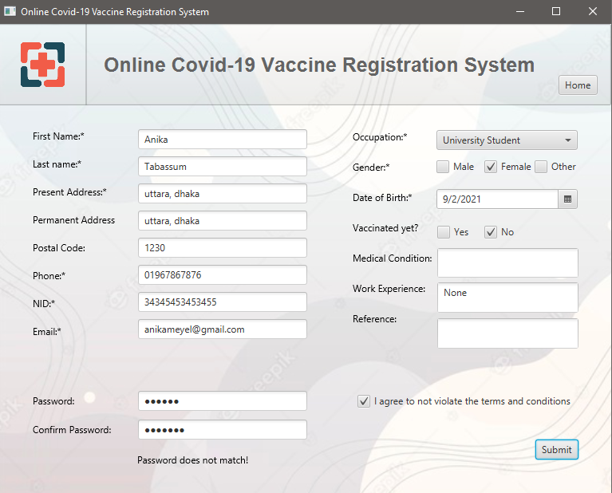
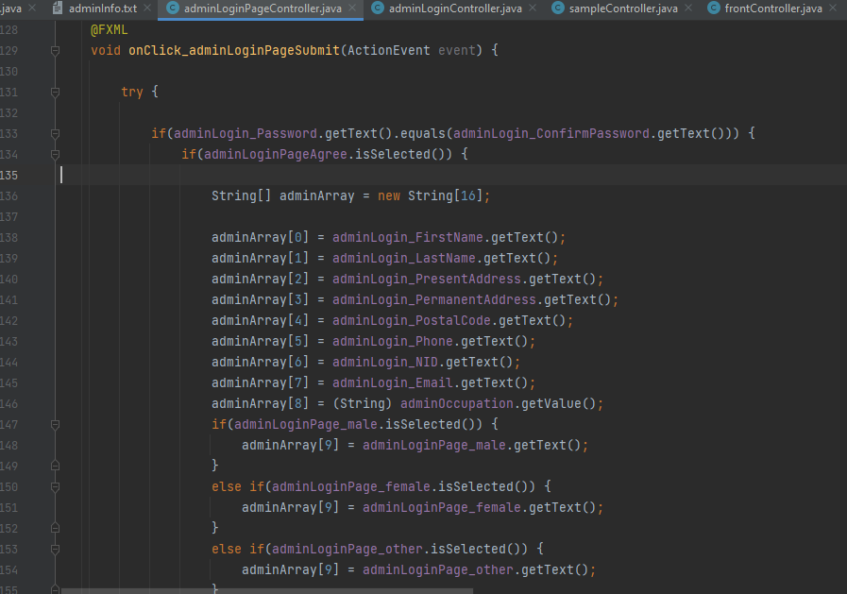
Volunteers registration process:
Volunteers need to provide their required
information to serve this system.
The system will not allow you to submit your
form untill and unless your password didn't
matched.
Finally after pressing the “Submit” button
the registraion will be completed.

Slide 9
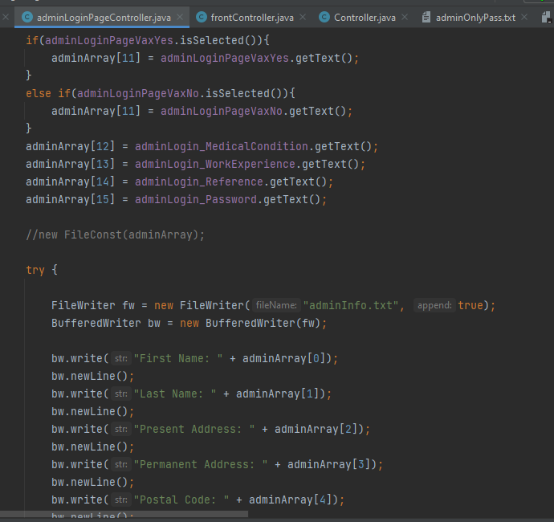
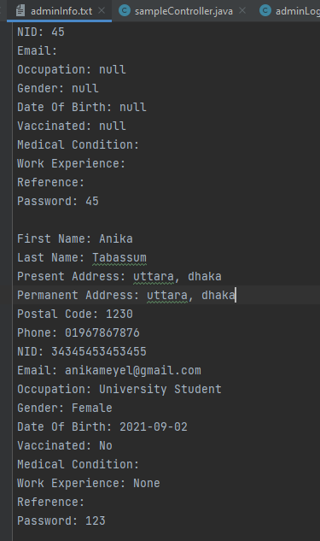
Storage system for our Volunteers:
Again, each and every required informations of our Volunteers are being stored in our storage system(File).

Slide 10
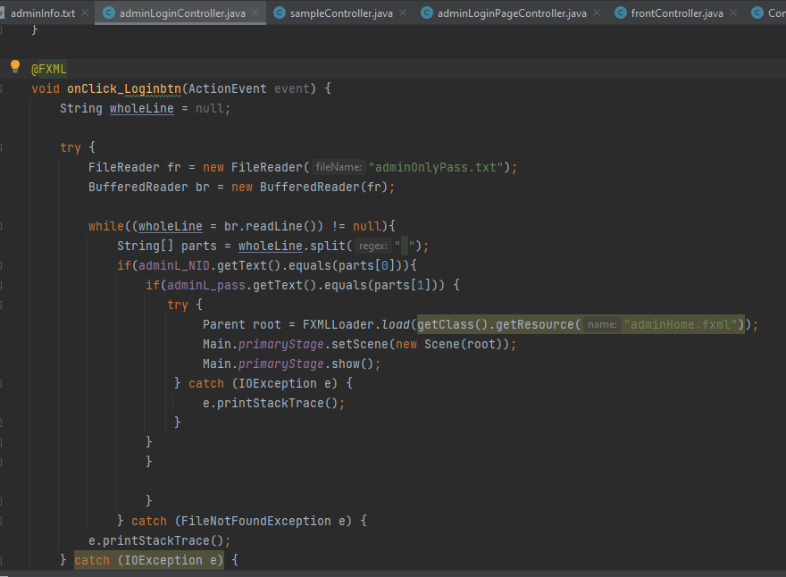
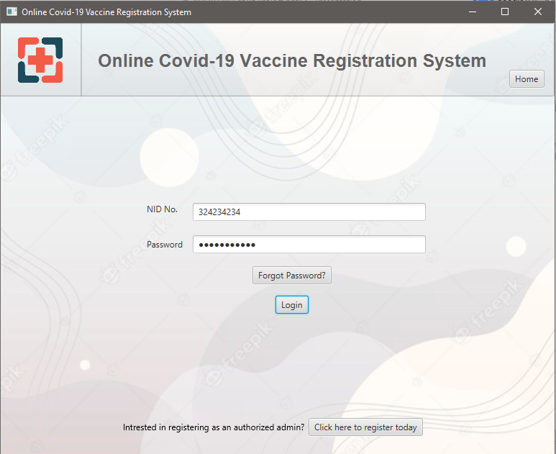
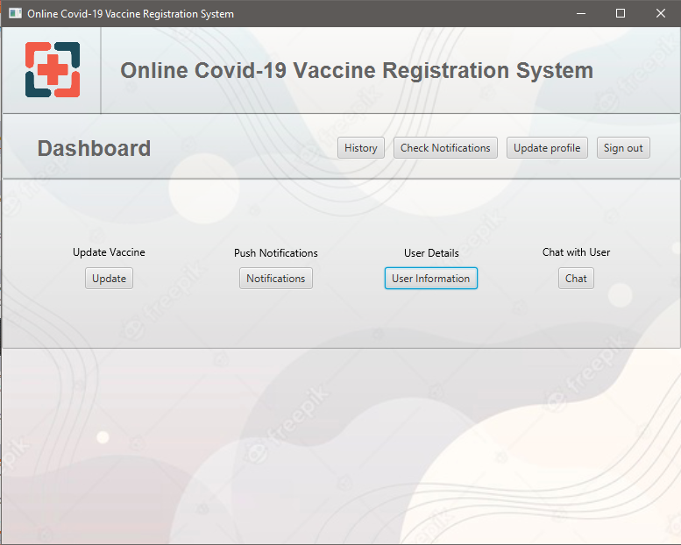
It's our Volunteer's Login UI:
Password have to be matched in order
to get access in their individual's profile.
If the password get matched then the
Volunteers will get accessed to thier
Volunteer's Dashboard to ensure thier
responsiblities.

Slide 11
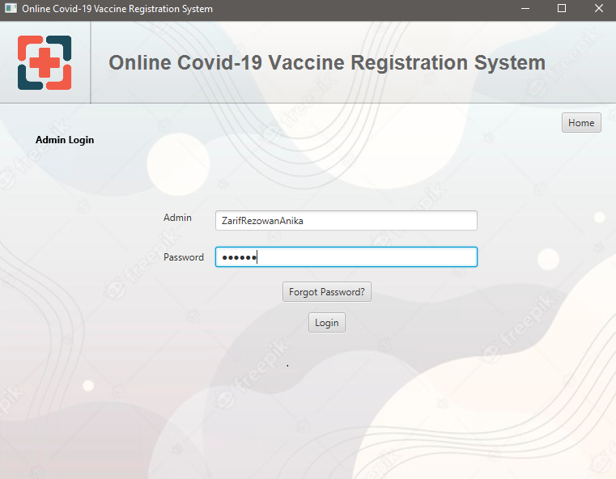
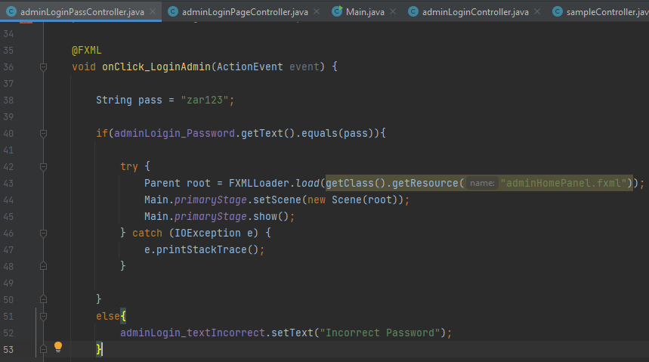
Admin Login UI:
We can get back to our home
page from any other pages simply
by pressing the “Home” button.
This is secured and only the three admins could access this panel. And the password is “zar123”.
Also the password need to be matched otherwise the system will not give you the access.

Slide 12
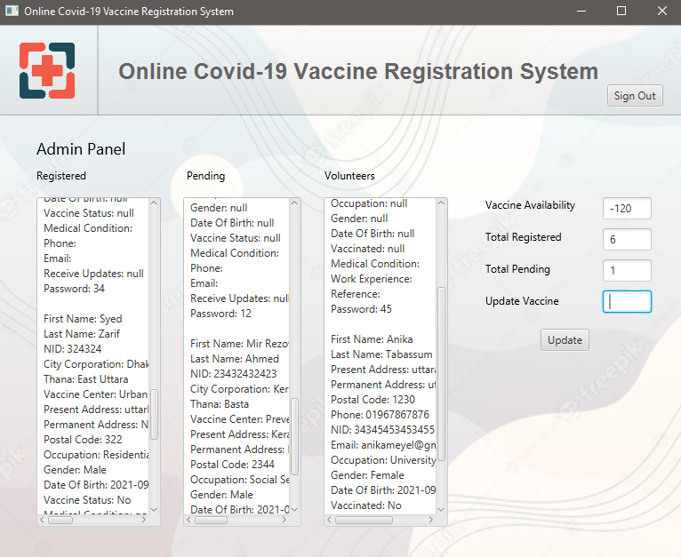
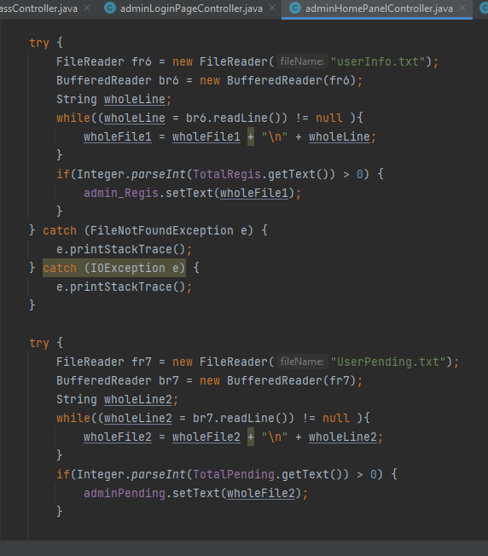
Admin Monitoring Panel:
We can observe the details of the Users who are getting resistered.
We will get a pending list of the Users those who are not being able to be registered due to the stortage of the vaccines.
We also maintain/store the details information of each Volunteers in this panel.

Slide 13
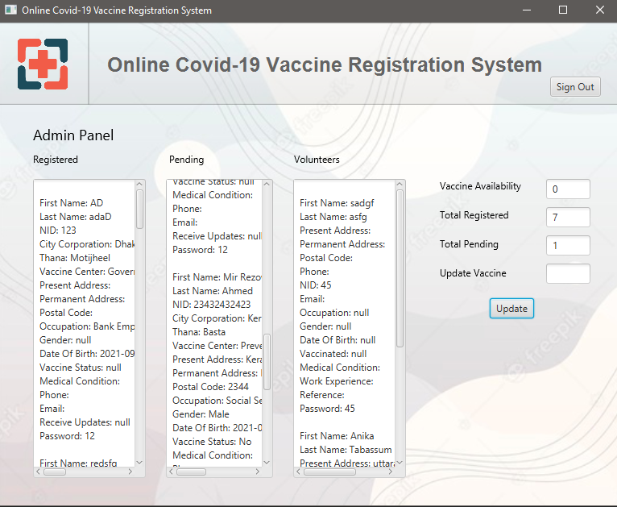
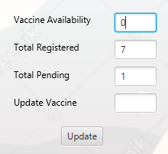
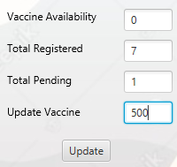
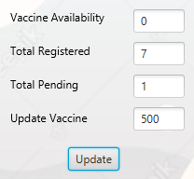
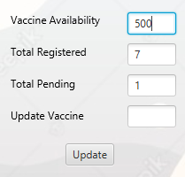
Vaccine updating process(frontend):
If any User tried to be registered at the time of shortage of vaccines then the “Total pending” box will get increasing.
We can update vaccines from our end if the “Vaccine Availability” box gets “0!”.

Slide 14
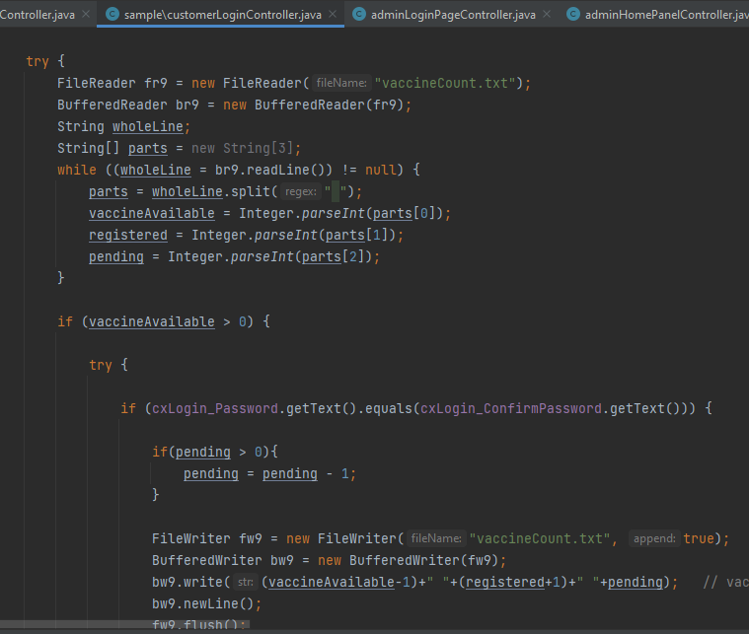
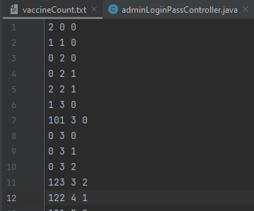
Vaccine updating process(backend):
When the vaccine count reaches “0” then we can add more vaccines according to our need.
With the help of this three token we can maintain this updating process.

Slide 15
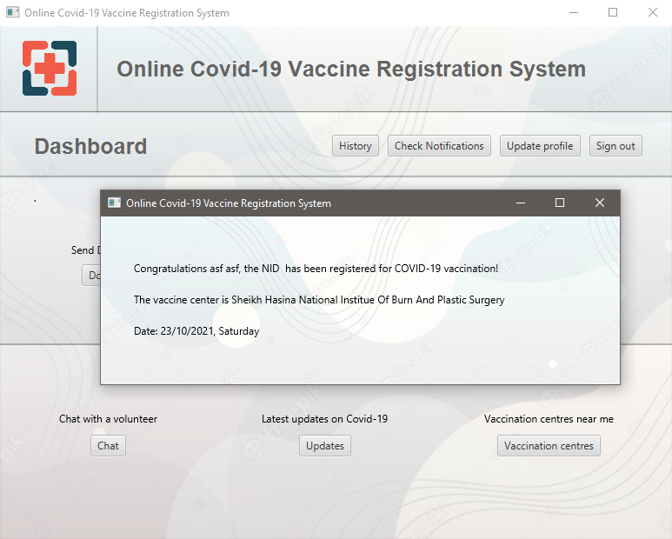
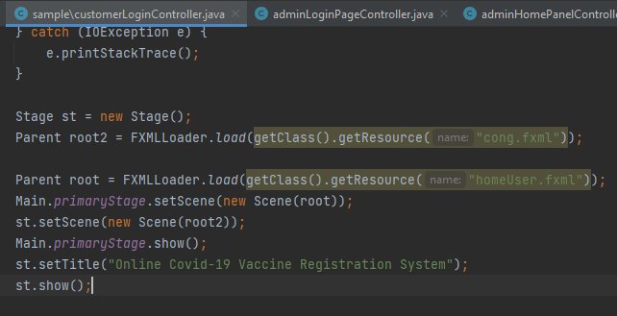
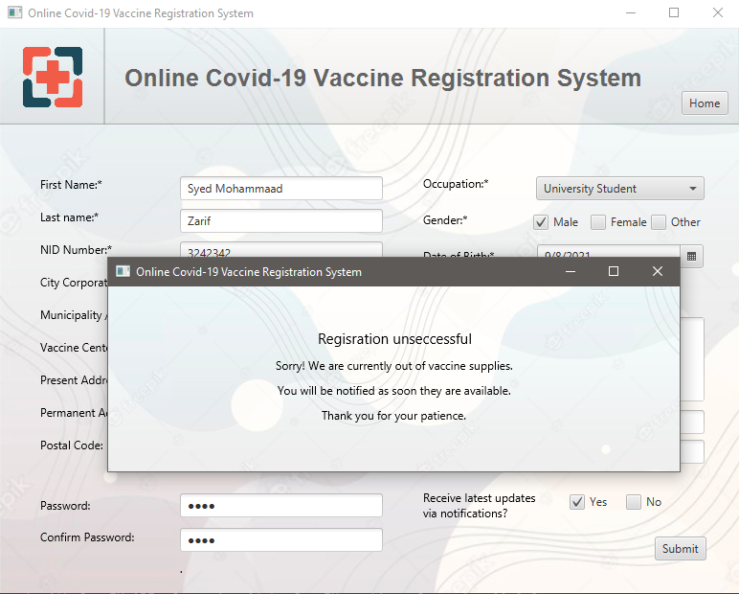
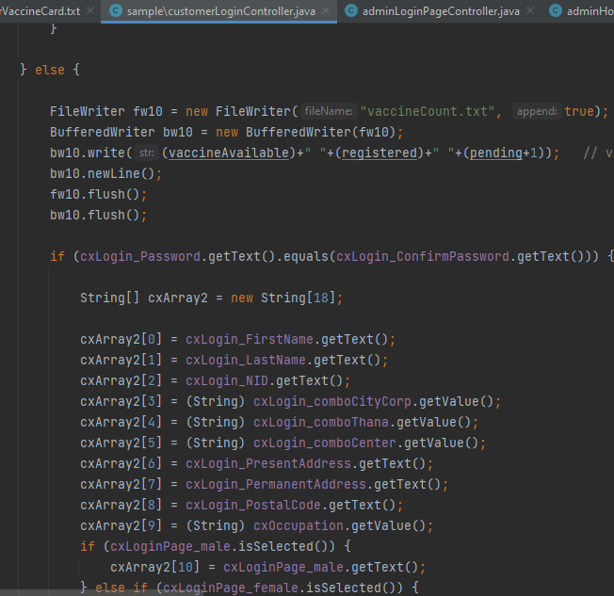
Ending of the process:
After completing the registration process successfully the User will get into their individual's Dashboard to get the required infromation.
If any User tried to be registered at the time of “Vaccine availablity 0!” then he/she will recieves a sorry message from our end.

Slide 16
Thank you all.
Q/A

